Slide 1
COMP 5566 Lab 7:
EOSIO Security - reproduce CVE-2022-27134
Mar. 10th 2023
Presenter: Weimin Chen

Slide 2
Before you read
In Lab 1, we had prepared a VMware image settled for attack demos. You can use it for this Lab as well.
If you are not in Lab room, You only need to install the VMware Workstation Player in your Windows OS computer, download my VM image, and load the VM image.
The computers in Lab room 604 A&B have already installed the VMware Workstation Player, and copied my VM image on desktop. If you would like to come to lab room 604 for tutorial, you are not required to install the VMware Player and download the VM image.
When you boot up computers in PQ604 A&B, you need to choose the COMP5566 device from the Boot Menu by tapping 2. In such cases, you will enter the system with environments configured by me.
VM Account: user Passwd : 1234
For students who want to build the lab environment from scratch, I provide a Github repository https://github.com/zzzihao-li/COMP5566 which maintains guidelines for setting up the environment and conducting the attacks.
In this Lab, we will only need Docker

Slide 3
Download the Code before Lab5
To launch the environment for demonstrating attacks, you only need to
Obtain the EOSIO Docker environment
git clone https://github.com/wasai-project/wasai.git
Obtain the POC and its Docker environment
git clone https://github.com/Kenun99/CVE-batdappboomx.git to download the repo

Slide 4
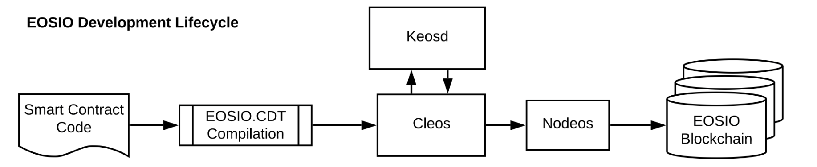
EOSIO Components
The EOSIO platform provides a number of components and libraries which are used to operate blockchain nodes, collect blockchain data, to interact with these nodes, and to build smart contracts.
nodeos (node + EOSIO = nodeos). This is the core EOSIO node daemon that can be configured with plugins to run a node. Example uses are block production, dedicated API endpoints, and local development.
Cleos (CLI + EOSIO = cleos) is a command line interface which interacts with nodeos, allowing you to send commands and actions to a blockchain.

Slide 5
EOSIO Components
keosd (key + EOSIO = keosd) is a local component that securely stores EOSIO keys. Cleos also interacts with it to manage EOSIO keys.
EOSIO.CDT is the toolchain and libraries for smart contract developers, which generate the WebAssembly binary instructions or bytecodeinto wasm files. The generated wasm files are the smart contracts which can be deployed to EOSIO blockchains.

Slide 6
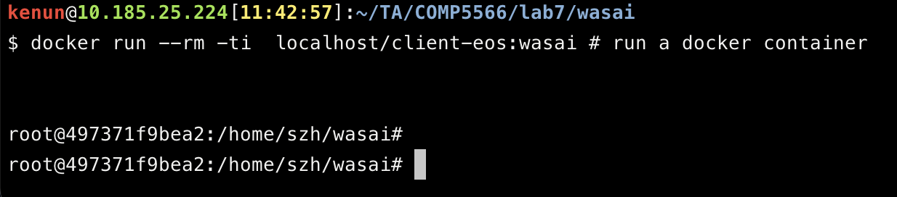
Environment Setup
Download the Dockerfile from our repo
git clone https://github.com/wasai-project/wasai.git && cd wasai # download the code
Build the Docker image at local.
sudo docker build -t localhost/client-eos:wasai .
Run a Contrainer to setup the lab environment
sudo docker run --rm -ti localhost/client-eos:wasai # run a docker container
Then you should be in the container environment

Slide 7
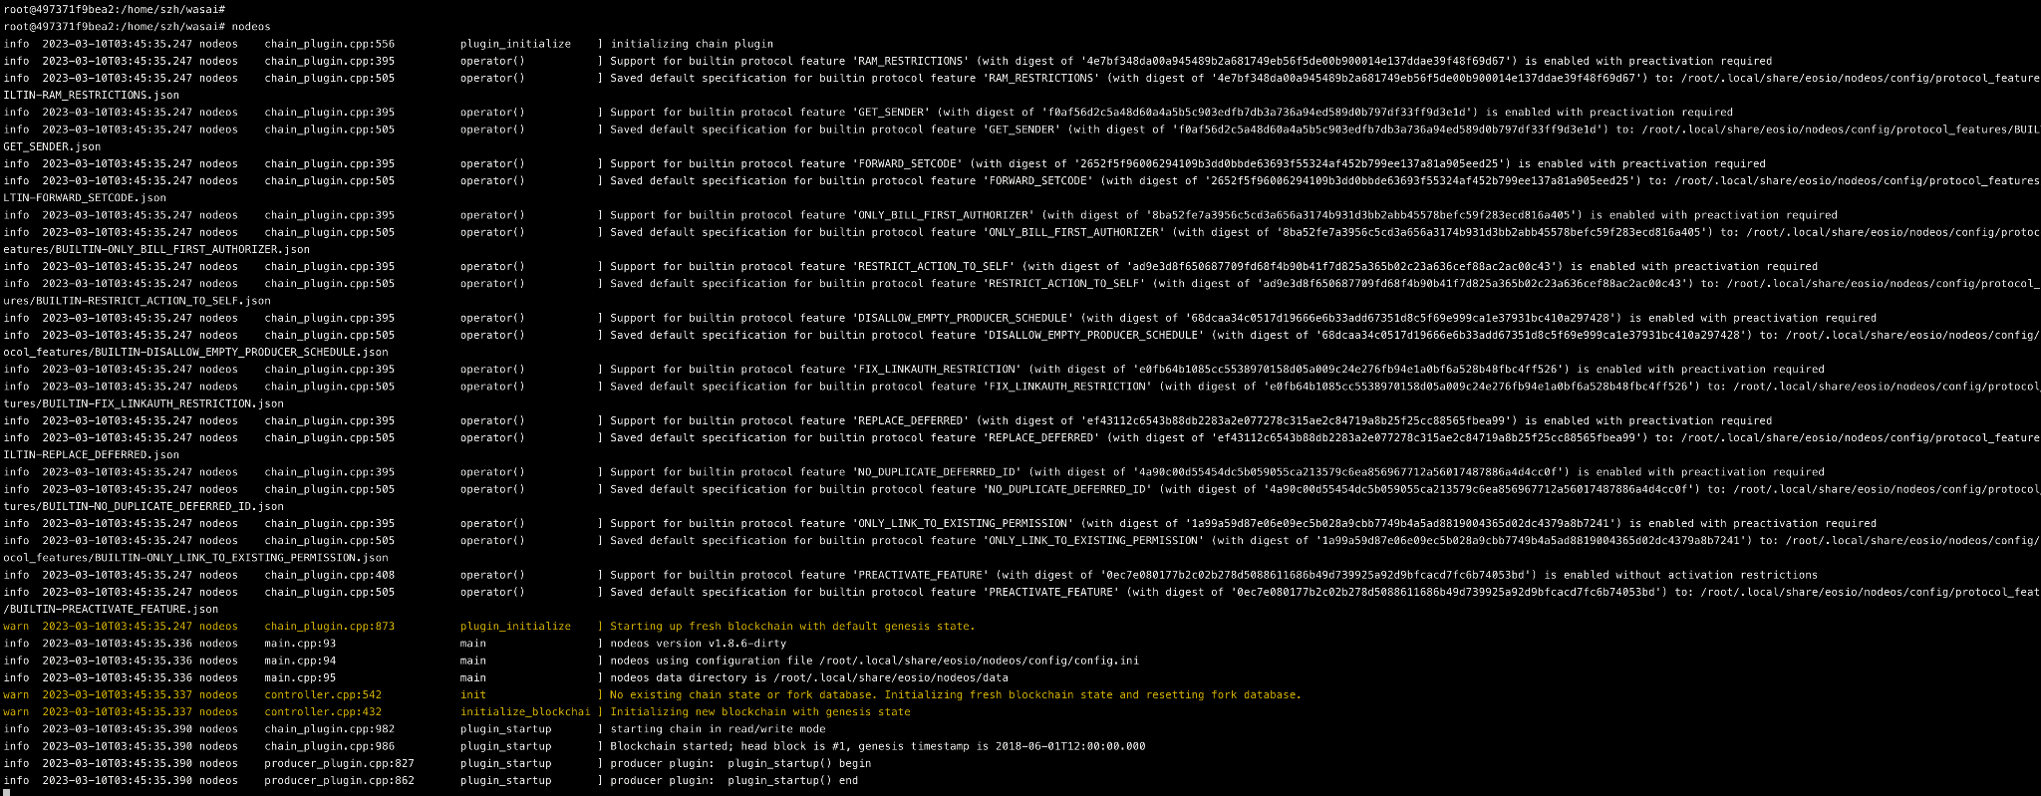
Environment Setup
play with nodeos $nodeos
Follow the document to deploy a smart contract
https://developers.eos.io/welcome/v2.2/smart-contract-guides/deploy-issue-and-transfer-tokens

Slide 8
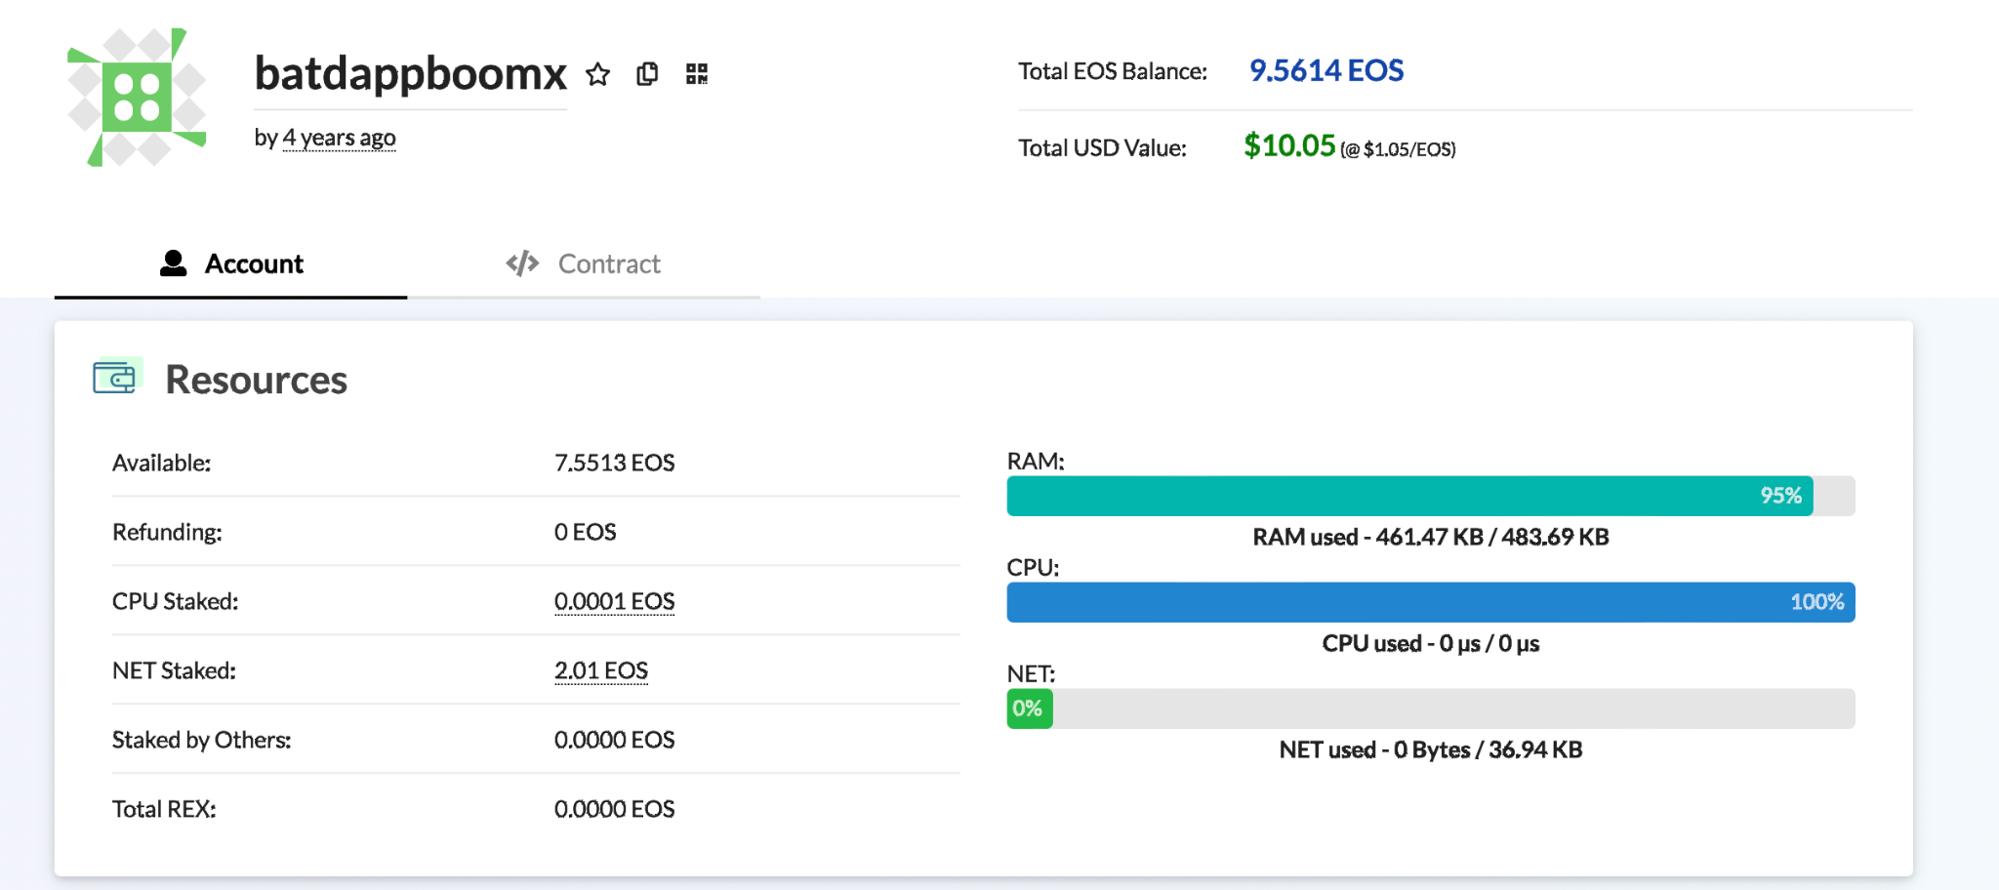
Victim
batdappboomx is a public smart contract running in the EOSIO blockchain.
The latest version of this smart contract. The sha256 hash code of the smart contract is 1327c04cf4b56183eddb1a897bbebf5a873d3421272b708829a4ed0765bef820
Check it at the blockchain explorer https://bloks.io/account/batdappboomx

Slide 9
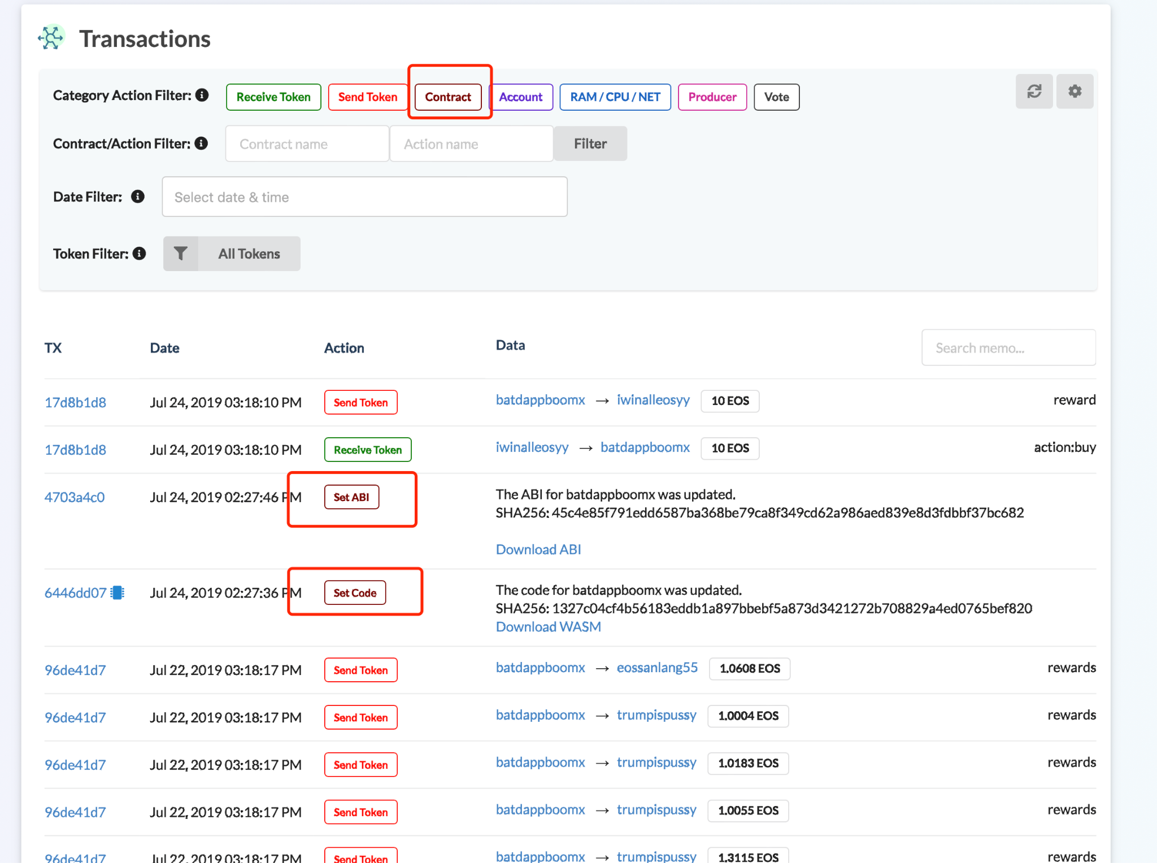
Victim
Download Code and ABI from bloks.io, i.e. https://bloks.io/account/batdappboomx
Demo

Slide 10
Victim
Go back to the host environment
Download the POC from the repo
git clone https://github.com/Kenun99/CVE-batdappboomx.git && cd CVE-batdappboomx
Build the Docker Image at local
docker build -t localhost/client-eos:eos .
Run the POC in a Docker Container
docker run --rm --network host -it localhost/client-eos:eos

Slide 11
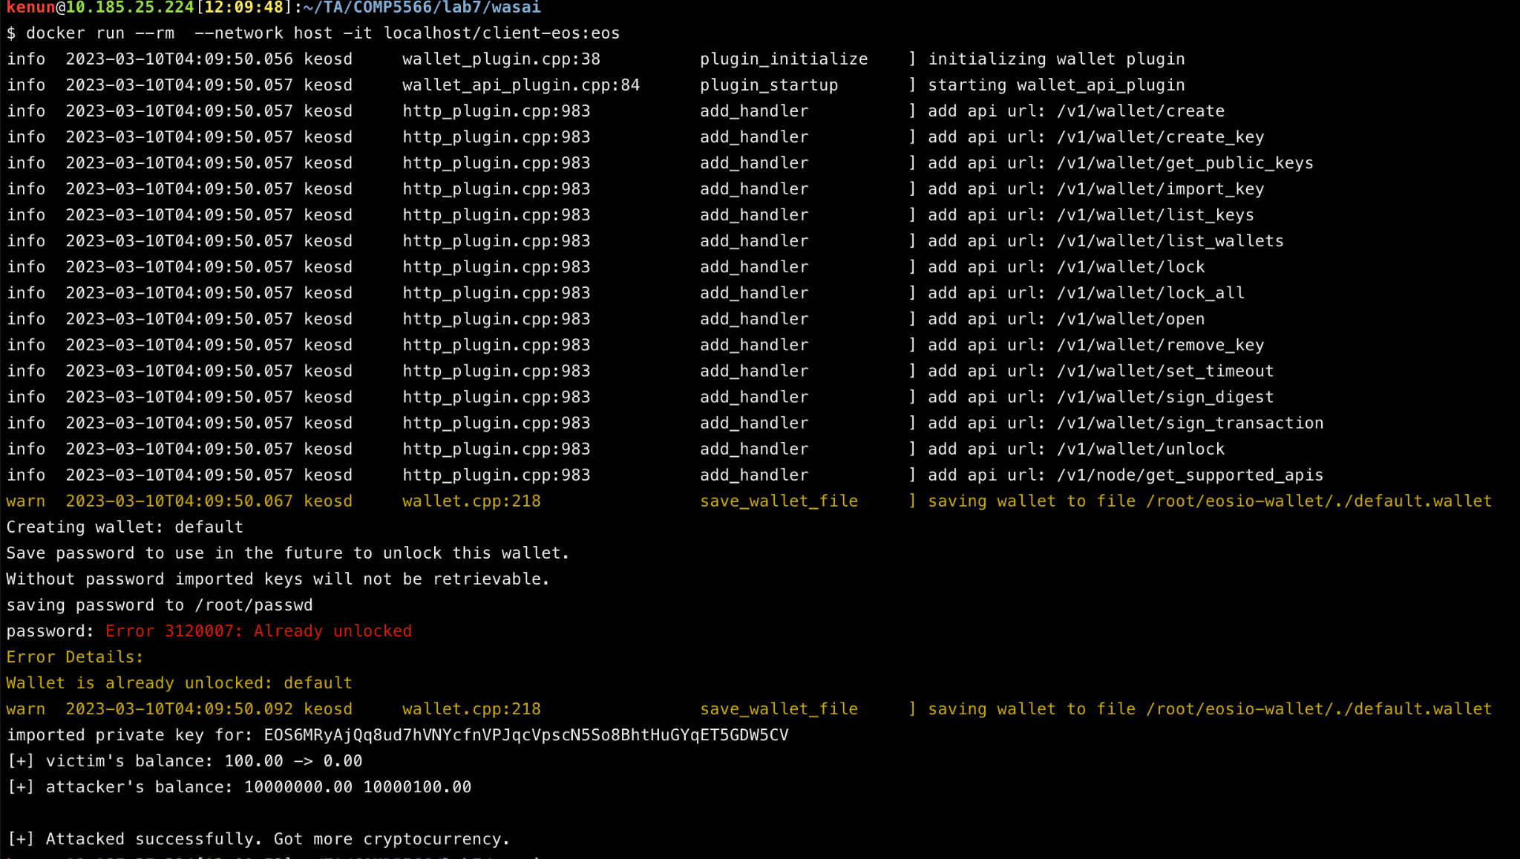
Victim
Go back to the host environment
Download the POC from the repo
git clone https://github.com/Kenun99/CVE-batdappboomx.git && cd CVE-batdappboomx
Build the Docker Image at local
docker build -t localhost/client-eos:eos .
Run the POC in a Docker Container
docker run --rm --network host -it localhost/client-eos:eos

Slide 12
Thank You Very Much!
Q&A

